Slide 1
Deploy a LAMP Stack Application to Amazon Lightsail
COMPRINNO TECHNOLOGIES-ASSESSMENT
PREPARED BY,
ROSHAN VIJAY V S

Slide 2
Lightsail:
Amazon Lightsail is a AWS service easy-to-use virtual private server (VPS) instances, containers, storage, databases,more at a cost-effective monthly price.
The main benefit is it's simplified setup and management processes allow businesses to quickly deploy and maintain their applications.
LAMP Stack:
A LAMP stack is a bundle of four different software technologies that developers use to build websites and web applications.
LAMP is an acronym for the operating system, Linux; the web server, Apache; the database server, MySQL; and the programming language, PHP.

Slide 3
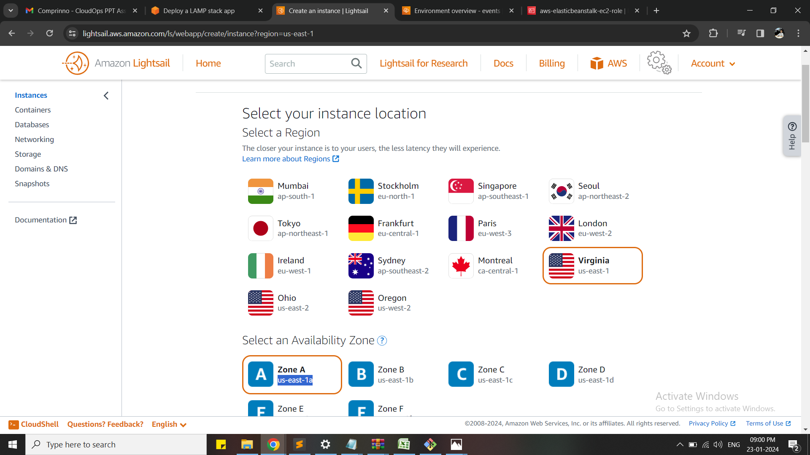
Step1:
In the AWS Management console, go to Lightsail.
Then Create an Instance
Then select the required AWS region and Availability zone

Slide 4
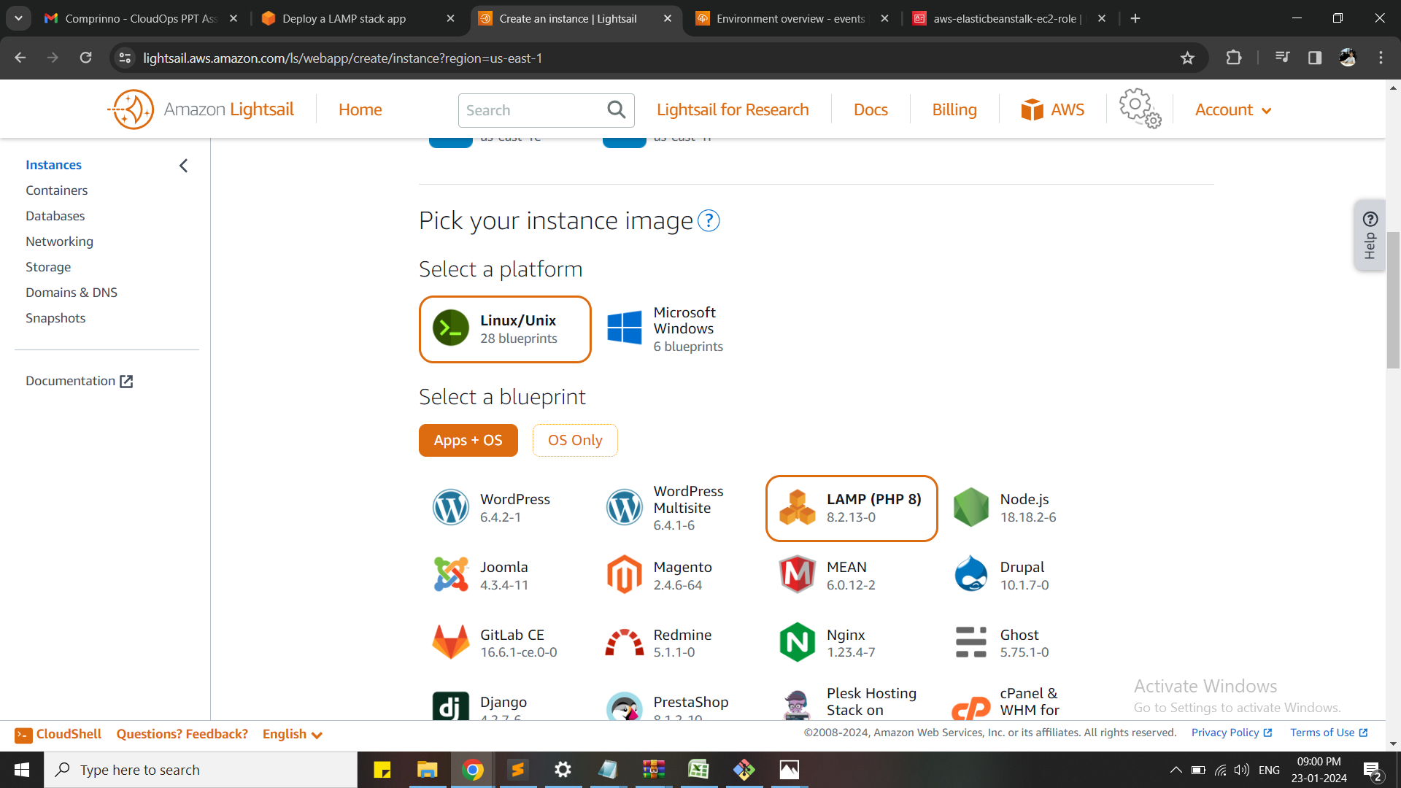
Step2:
Select the Image as Linux (Platform)
Select the blueprint (APP + OS) as LAMP

Slide 5
Step 3:
Add the Launchscript/user data to configure the instance
Clone the directory
Change the writing permission on setting file
Creating the database
Change the SSH key pair → create new key pair
Then select the required instance cost plan

Slide 6
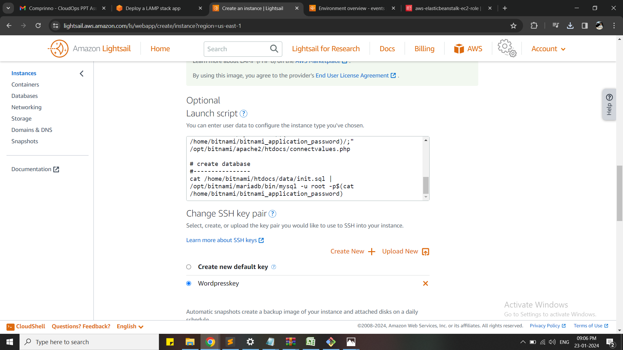
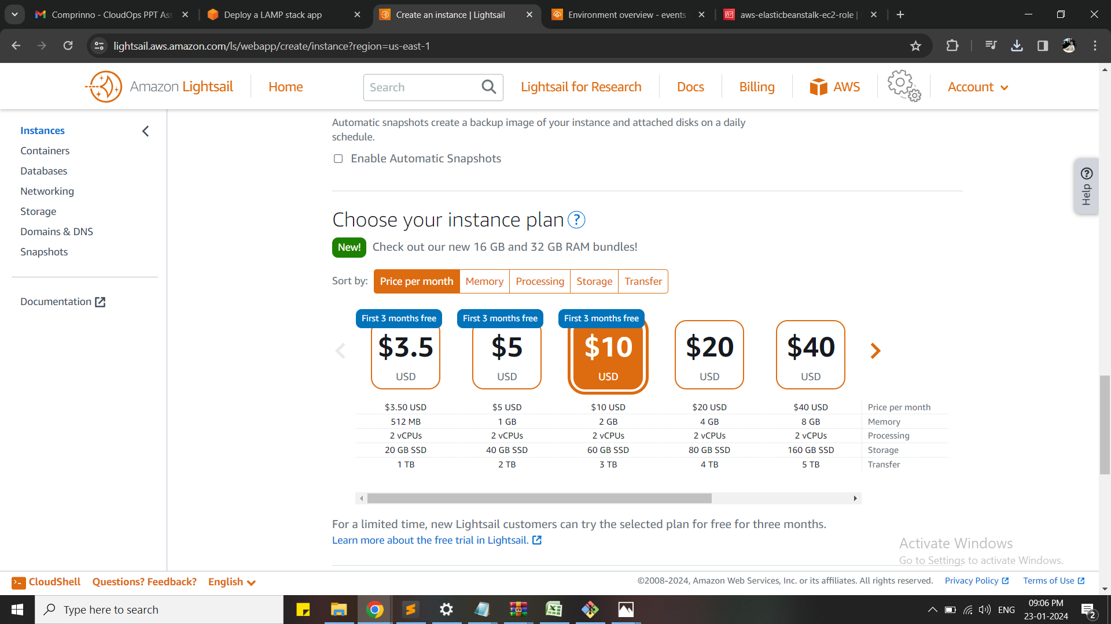

Slide 7
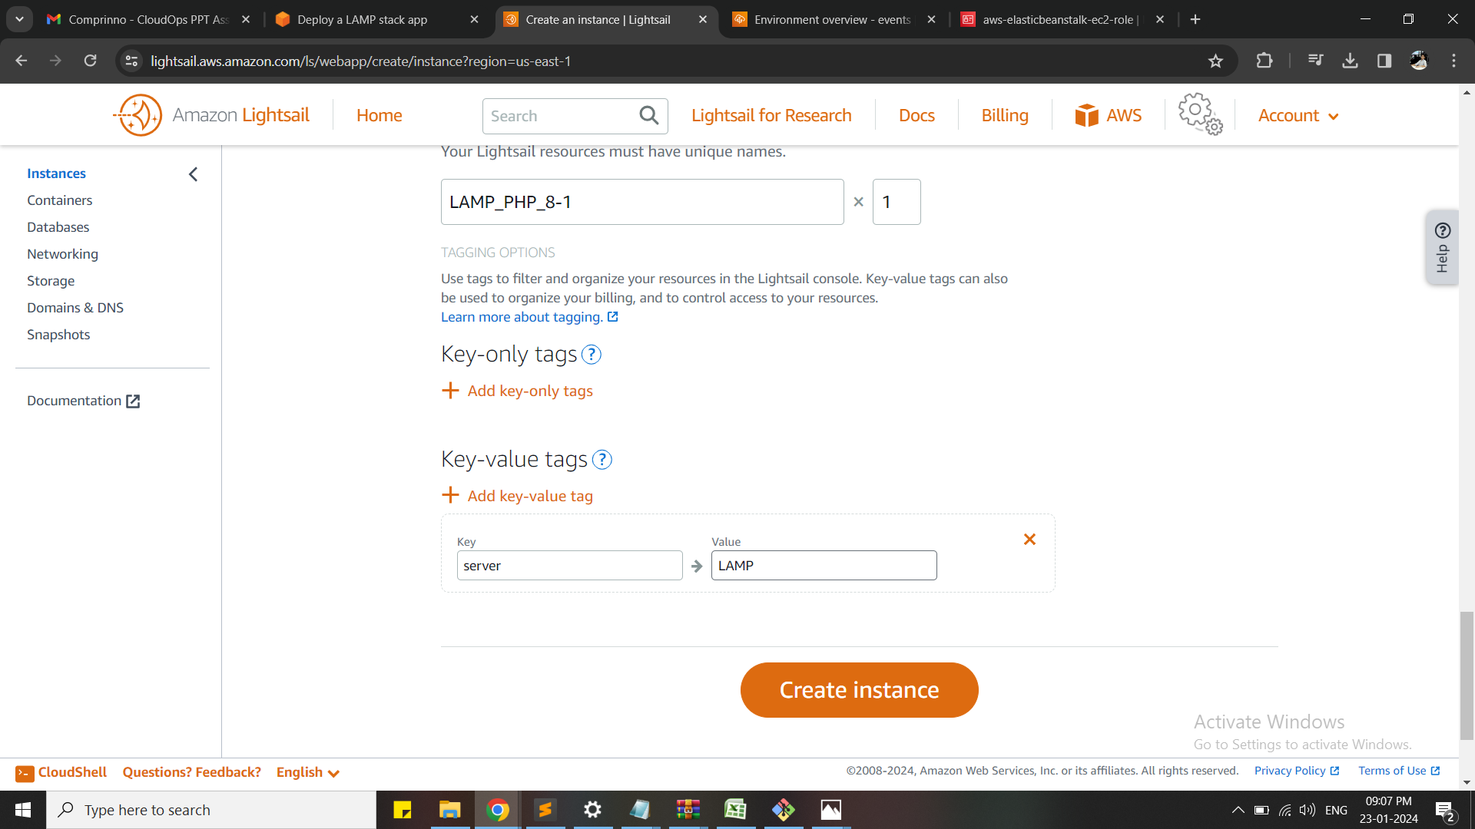
Step 4:
Provide a name to the instance
Provide key- tag values
Key as server and tag as LAMP
Then create the instance

Slide 8
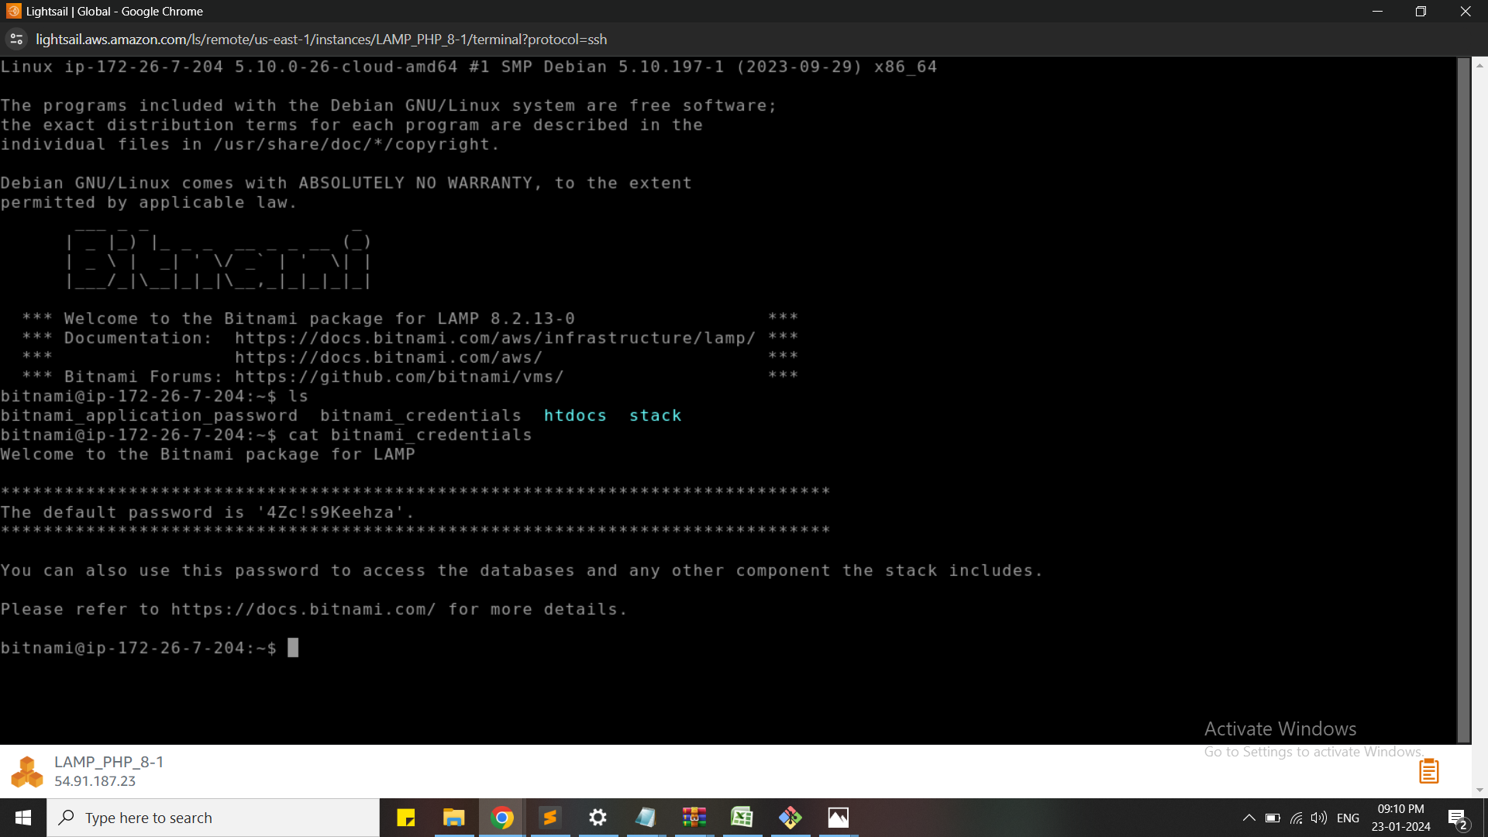
Step 5:
Using the terminal,connect the instance using SSH
Make sure the server is running

Slide 9
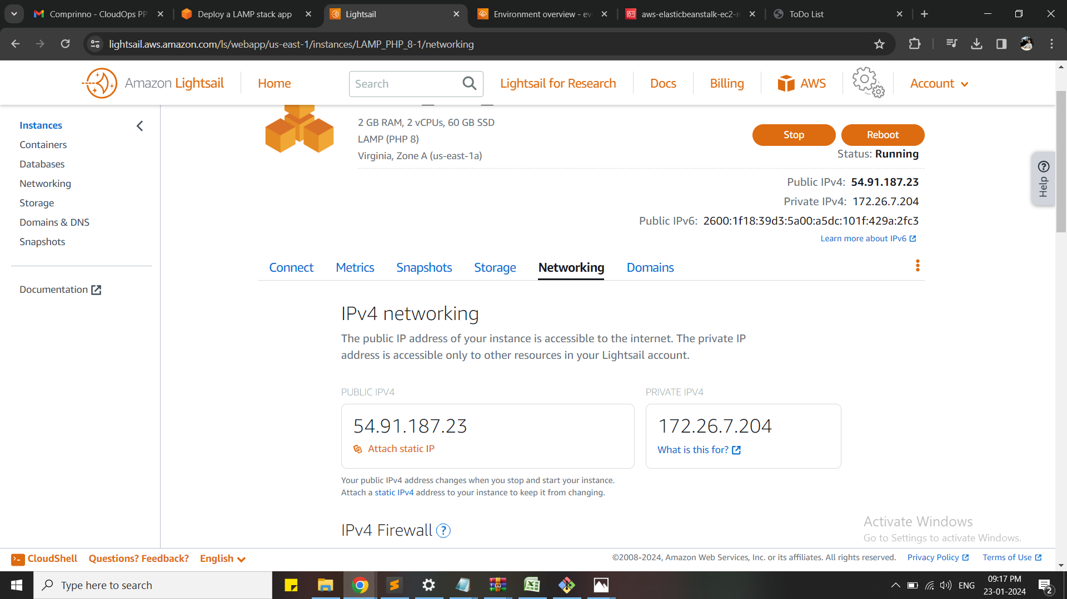
Step 6:
Copy and paste the public IP of the instance in new tab of the browser and make sure the Application is running

Slide 10
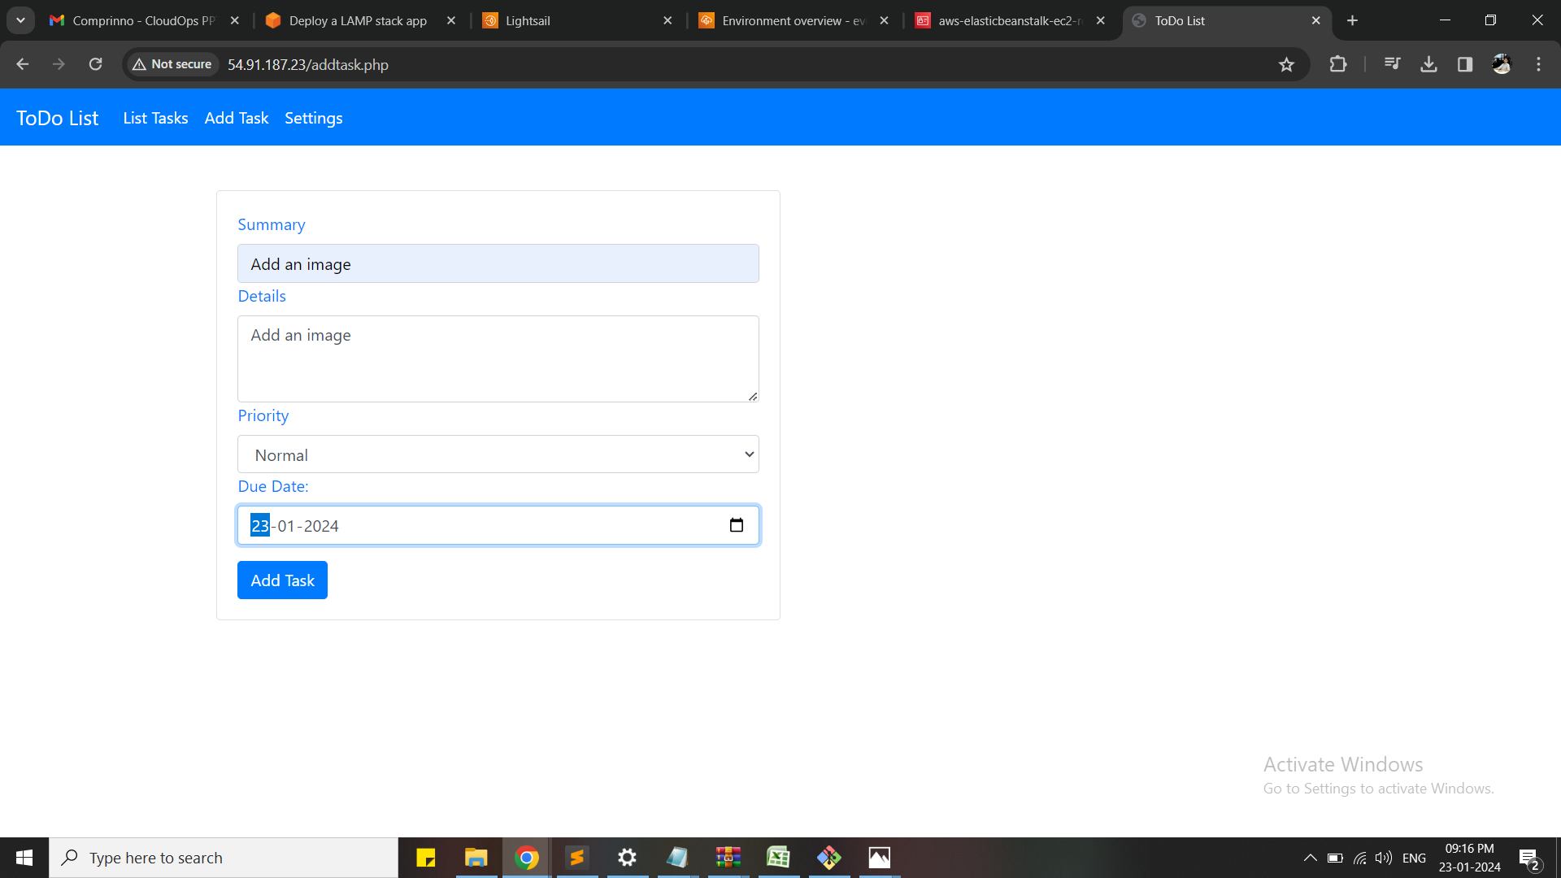
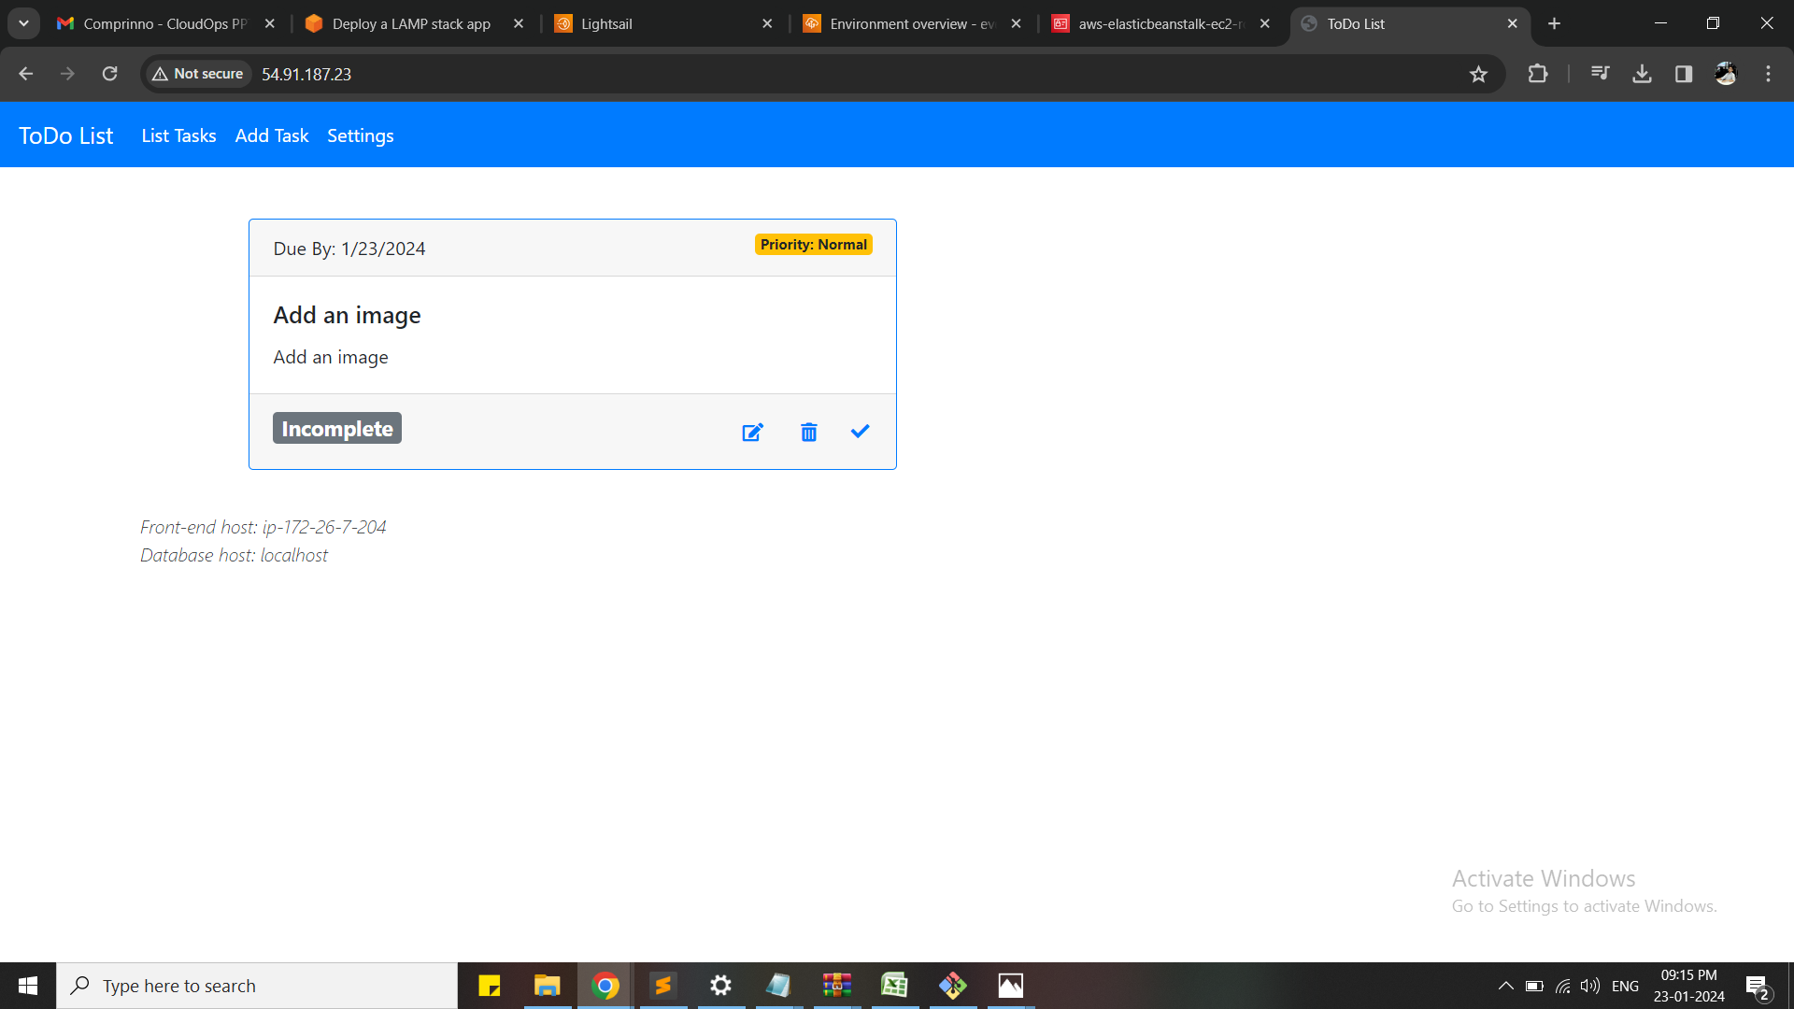

Slide 11
Now the LAMP stack application is successfully deployed

